Slide 1
DAA ASSIGNMENT-2
NIM GAME
MAREPALLY SAI TEJA
160120733167

Slide 2
PROBLEM STATEMENT:
Given a number of piles in which each pile contains some numbers of stones/coins. In each turn, a player can choose only one pile and remove any number of stones (at least one) from that pile. The player who cannot move is considered to lose the game (i.e., one who take the last stone is the winner).

Slide 3
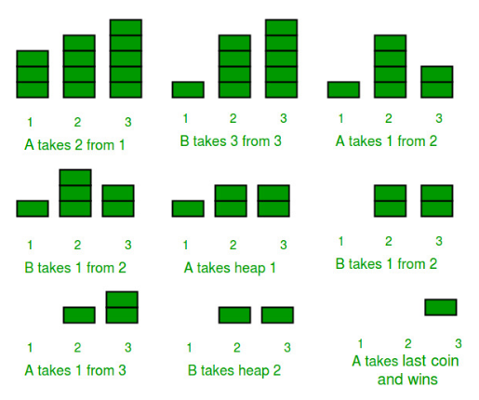
GAME DESCRIPTION:
CASE-1: A STARTS THE GAME WITH 1,4,5 STONES IN 3 PILES.

Slide 4
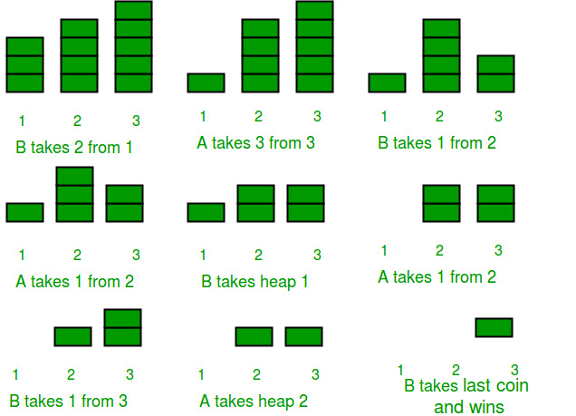
CASE 2:
B STARTS THE GAME AGAIN WITH THE SAME CONFIGURATION

Slide 5
->So does the player who starts first will win everytime? Let us again play the game, starting from A , and this time with a different initial configuration of piles. The piles have 1, 4, 5 coins initially.
->From the above two cases we can observe that the one who started the game has won the game.

Slide 6
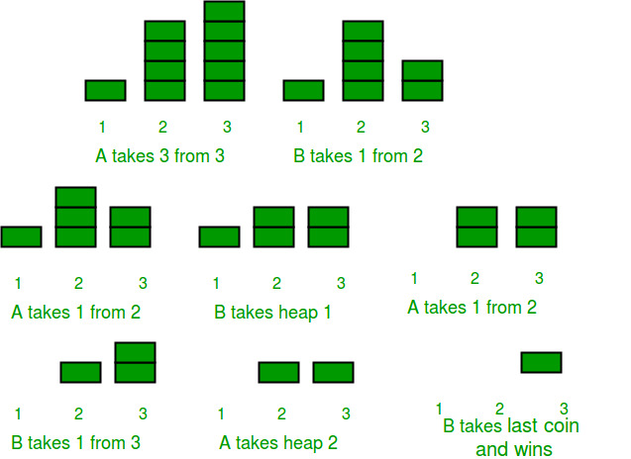
CASE-3: NOW A STARTS THE GAME WITH DIFFERENT CONFIGURATION

Slide 7
From the above case we can observe that A started the game but has lost the game.
This time the initial configuration was different from the previous one.

Slide 8
So, we can conclude that this game depends on two factors-
The player who starts first.
2. The initial configuration of the piles/heaps.

Slide 9
OPTIMAL SOLUTION
If both A and B play optimally (i.e- they don’t make any mistakes), then the player starting first is guaranteed to win if the Nim-Sum at the beginning of the game is non-zero. Otherwise, if the Nim-Sum evaluates to zero, then player A will lose definitely.
Nim-Sum : The cumulative XOR value of the number of coins/stones in each piles/heaps at any point of the game is called Nim-Sum at that point.

Slide 10
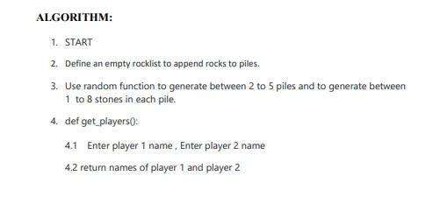
ALGORITHM

Slide 11
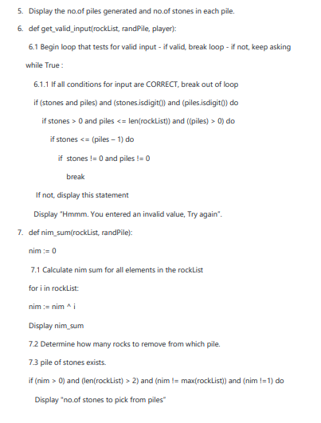

Slide 12
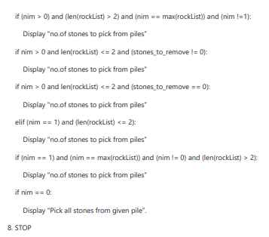

Slide 13
TIME COMPLEXITY
Time complexity of the for loops in the given algorithm is O(n)
>Time complexity of the if-else statements in the loops are O(n) and Time complexity of if statements which are not included in the loops are O(1).
>Therefore, Time complexity of the above algorithm is O(n) .

Slide 14
CONCLUSION
Therefore , Nim-game is a mathematical game of strategy in which two players take turns removing (or "nimming") objects from distinct heaps or piles.
The cumulative XOR value of the number of coins/stones in each piles/heaps at any point of the game is called Nim-Sum at that point.
Thus using Nim-sum we calculated no.of stones to be picked from each pile by each player.
Thus by the above algorithm we demonstrated the game of Nim

